Slide 1
California:
“Water Flows Uphill to Money”
DZ05 Lecture 12/5/2005
Sources: Cadillac Desert, by Marc Reisner, 1993, and POD Documents
Notes:
Source: Cadillac Desert, by Marc Reisner, 1993.

Slide 2
California – some Background
Agriculture is the largest industry in the state
$18 Billion/year (1992) out of a state “GNP” of $485 Billion/year
CA uses 30% of the national pesticide production
Agriculture uses 81% of the water in the state, irrigating land that would otherwise be desert.
60% of that water comes from rivers (the rest is groundwater – mostly pumped at unsustainable rates)
Almost all the rain that falls on the state is used at least once by humans before it evaporates or flows to the sea

Slide 3
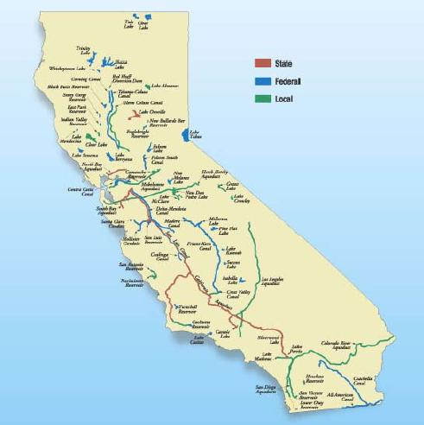
California Rivers, Reservoirs, and Aqueducts
The Central Valley (Sacramento Valley and San Joaquin Valley) get most of their water from aqueducts (largely from the Sacramento River) and groundwater
Los Angeles currently gets water from the Colorado River, the Owens Valley, and the Sacramento River (California Aqueduct)
Delta-Mendota Canal
SF
California Aqueduct
LA

Slide 4
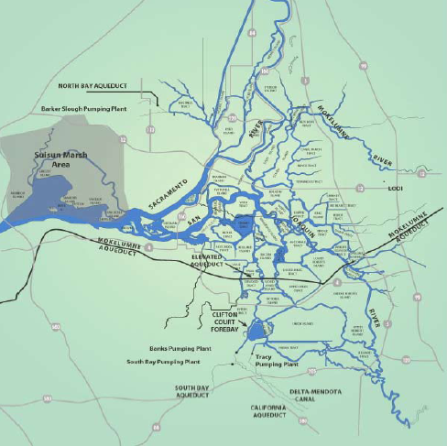
San Francisco Bay Delta
Most water comes from the Sacramento River
30-60% is pumped out in the South Delta by the CVP & SWP *
These are actually able to reverse the flow in the Southern Delta
Confusing for fish!
CVP & SWP provide water for 20 million people and 4.5 million acres of farmland
*
*

Slide 5
Prehistory
1902 Reclamation Act (Federal)
Promoted large-scale irrigation of dry lands
We had little knowledge of potential problems such as salinization
1930’s Great Drought
Post-WWII: invention of the centrifugal pump made it more feasible to pump groundwater

Slide 6
CVP: Central Valley Project
1933 Central Valley Project Act (California, not Federal, but it was soon taken on by the Feds because it needed so much money)
FDR, Depression-era project
Done through the US Bureau of Reclamation
Built CVP to pump Sacramento River Water to the Central Valley (95% of CVP water goes to agriculture)
Supposed to support small (<160 acre) farms
In reality many farms were owned by large corporations: oil, railroad, agriculture

Slide 7
SWP: California State Water Project
The CVP didn’t irrigate the Southern San Joaquin Valley, and many large owners (esp. oil) had large tracts there
Political necessity: provide water to LA (need a lot of money to pay for it)
Built the California Aqueduct (near I-5)
Huge energy requirements for pumping
Justification: future development will be able to pay for water, no matter how expensive

Slide 8
Environmental Consequences: Sacramento River
4 runs of Chinook salmon, and many other fish
Before the Gold Rush (1849) the watershed had >6000 miles of spawning habitat
By the 1960’s this was reduced by 97%
Reason: dams (often motivated by irrigation, but facilitated politically by floods and drought)
1992 Pacific Fisheries Management Council places stringent limits on the catch of California salmon (drought 1987-1992…)

Slide 9
CVP: Act II
1992 Central Valley Project Reform Act
Takes some water from agriculture and devotes it wetlands and fisheries, esp. in the Delta
Urban CA voted for it because they had been rationed while agriculture had not
PNW voted for it to protect their salmon fleet
Other states voted for it because they felt that CA agribusiness has been getting more than its share of federal help

Slide 10
MOVIE
A Brief Cinematic Interlude
“Delta Revival”
US Geological Survey one of MANY players in the Delta

Slide 11
2005
POD: Pelagic Organism Decline!
Despite the 1992 CVP Reform Act certain (non-salmon) fish species in the Delta had record-low years since 2002
This was expected during low river flow years, but these years were moderate flow
At the same time, these fish had been showing up mostly in the “salvage” operation at the CVP and SWP pumping stations
This is of great concern to the State Water Contractors!

Slide 12
Action
Let’s have more scientific study of the problem…
And a Review Panel to study the Scientists

Slide 13
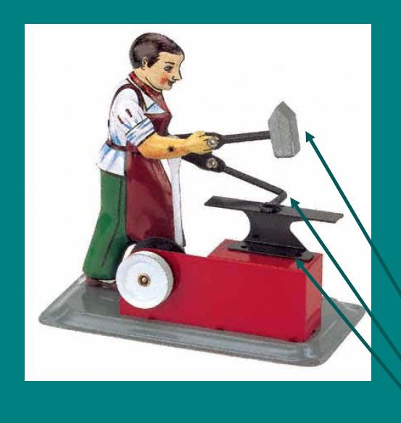
Combined Stressors
Loss of food due to competition from invasive species
Fish Populations
Loss of spawning adults from pumping by CVP & SWP

Slide 14
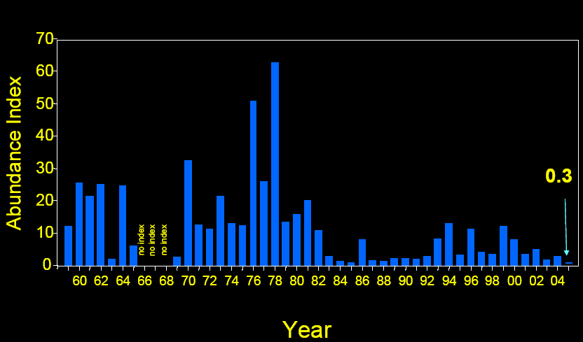
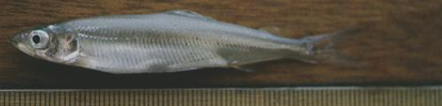
Delta Smelt (lack of) Abundance
This and several other species are listed as endangered or threatened by the state and federal governments
But the Problems are LONG-TERM, not recent..

